Slide 1
More than just
teaching:
Advocacy and activism around the globe
Hi!
Aluu!
Salut!
Ciao!
Jambo!
Oi!
TESOL ITALY, 2023

Slide 2
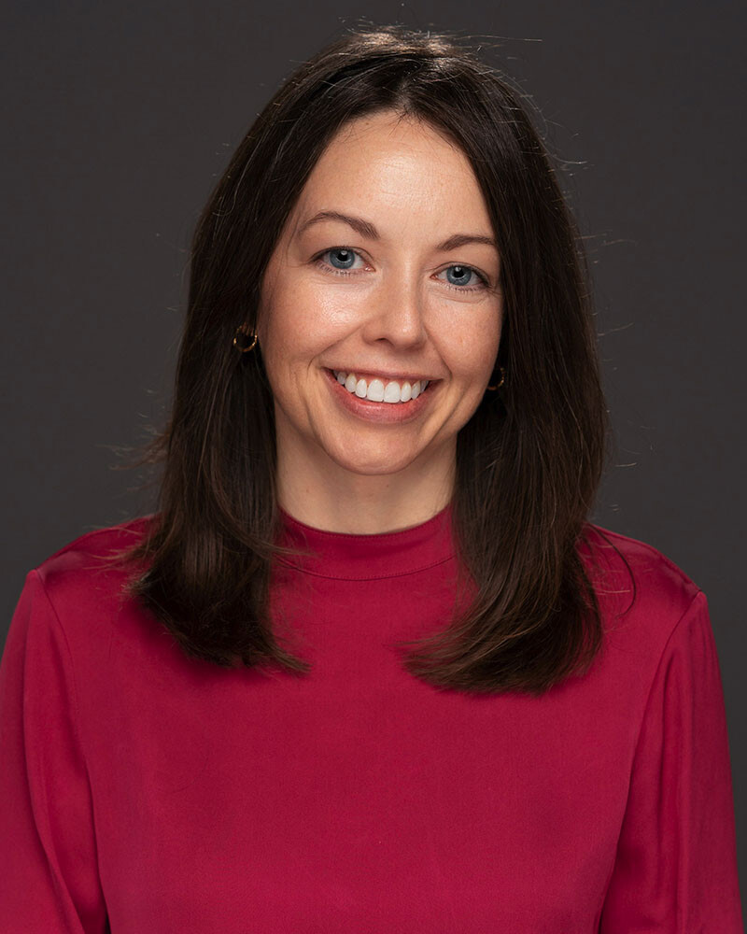
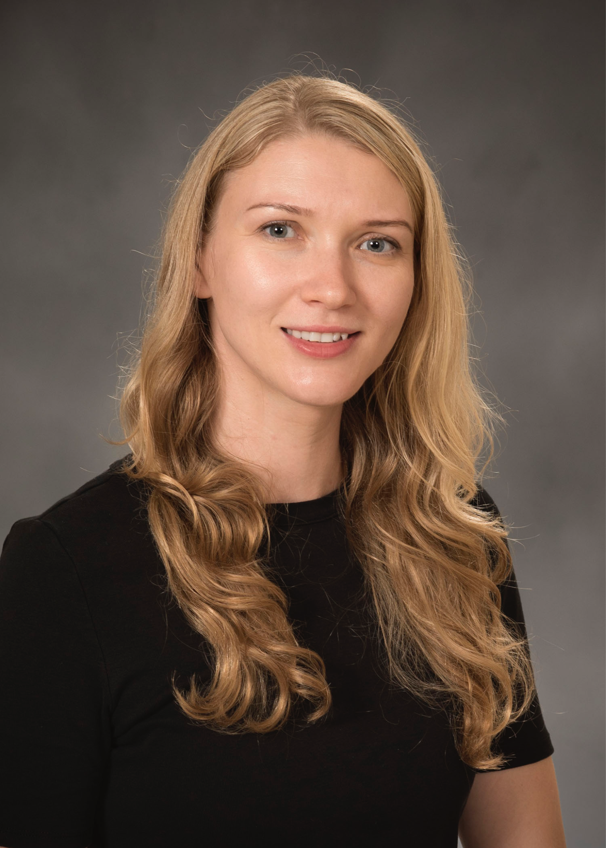
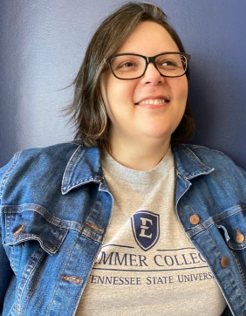
Introductions
Amber N. Warren
Natalia A. Ward
Maria Dias
Vanderbilt University
East Tennessee State University
East Tennessee State University

Slide 3


Why activism? Why advocacy?

Slide 4

Why activism? Why advocacy?

Slide 5
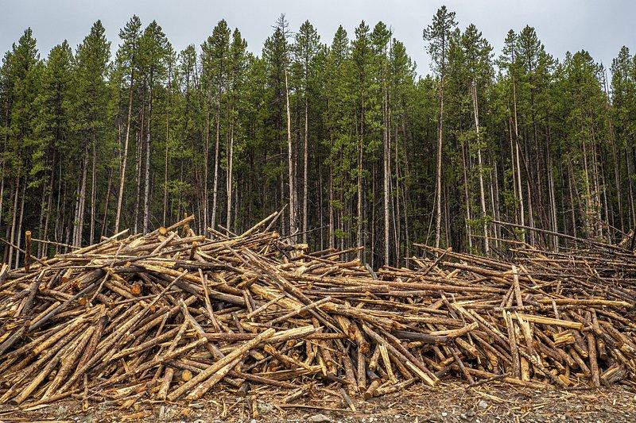
Why activism? Why advocacy?

Slide 6
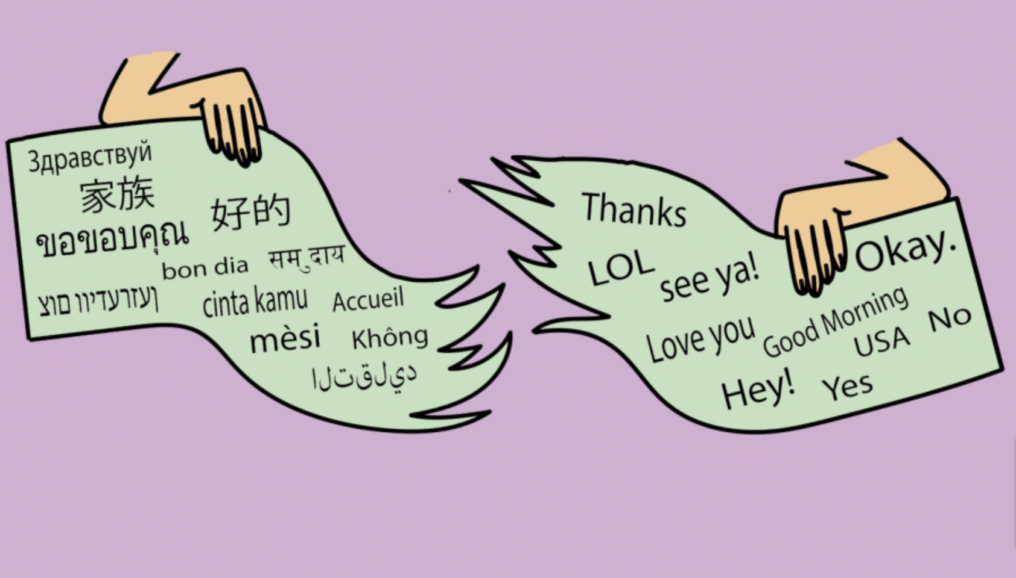
Why activism? Why advocacy?

Slide 7
Advocacy and Activism in LTE
ADVOCACY
Noticing a situation or issue and taking action to remedy it (Linville, 2020)
Taking a purposeful course of actions based on what a teacher believes is best for their students (Hoang & Truong, 2017)
Speaking up against injustice (Athanases & de Oliveira, 2007)
Within- and beyond-the-classroom (Dubetz & de Jong, 2011); Instructional and political (Linville, 2020)
ACTIVISM
Taking individual and collective actions to disrupt the status quo and enact transformative educational practices (Warren & Ward, forthcoming)
Working toward sustainable systems for deepening understanding, mitigating conflict, and promoting harmony within communities in conflict (Yumarnamto, forthcoming)
Growing sense of agency and empowerment to move ideas forward (Beauchamp & Thomas, 2009)
In LTE, advocacy and activism both involve: connecting course content with their lived experiences and the needs and concerns of their local communities (Avineri et al. 2019; Ortactepe Hart & Martel 2020).

Slide 8

Advocacy and Activism Involves
Personal and professional choices; Individual and collective actions
Taking actions (quiet and loud)
ELT in local context: Noticing needs and listening to the community
Expanded view of what counts as being a teacher
A critical stance; An orientation toward peace and transformation

Slide 9
Advocacy and Activism In Action
Assess needs
3. Carry out a plan
Start with the needs of your community of learners
Decide what form of advocacy or activism you want to pursue and implement your plan
2. Establish networks
Connect with likeminded people, engage in professional development networks, and build coalitions

Slide 10
Start with the needs of your community

Slide 11
Social Responsibility Projects in Türkiye and Indonesia
Merhaba!
Community-connected
Extensive (embedded in teacher education courses; spanning several months)
Expanding understanding of teachers as agents of change for equity and social justice
Selamat!

Slide 12
Social Justice in ELT Project (Türkiye)
Professional Learning to deepen knowledge of the issues
SRPs in Local Communities
Environmental education and sustainability; gender equality, LGBTQ+ inclusive pedagogies, peacebuilding
We-slexia; A Movie without Roles; Drama and Children’s Literature
Yilmaz et al., forthcoming

Slide 13
Leadership Projects (Indonesia)
Evaluation
Planning
Implementation
“I am becoming more sensitive to my surroundings and am increasingly trying to be able to help people around me in things that may be very trivial if valued in money. But these things are actually useful and helpful for the people I care about.”
“The teachers’ duties are not only to teach, but to educate so that students can become better individuals. One way is to teach students to do simple things that can help the people around them.”
Target communities: Community preschool; Street Children
Community service projects: Teaching English; Character Building
Yumarnamto, forthcoming

Slide 14
Familia ESL (United States)
Hispanic parent association
Monthly meetings
Events
Community support
Adult English classes
Hi!
Booker, 2023

Slide 15

Decide what forms of advocacy or activism to pursue

Slide 16
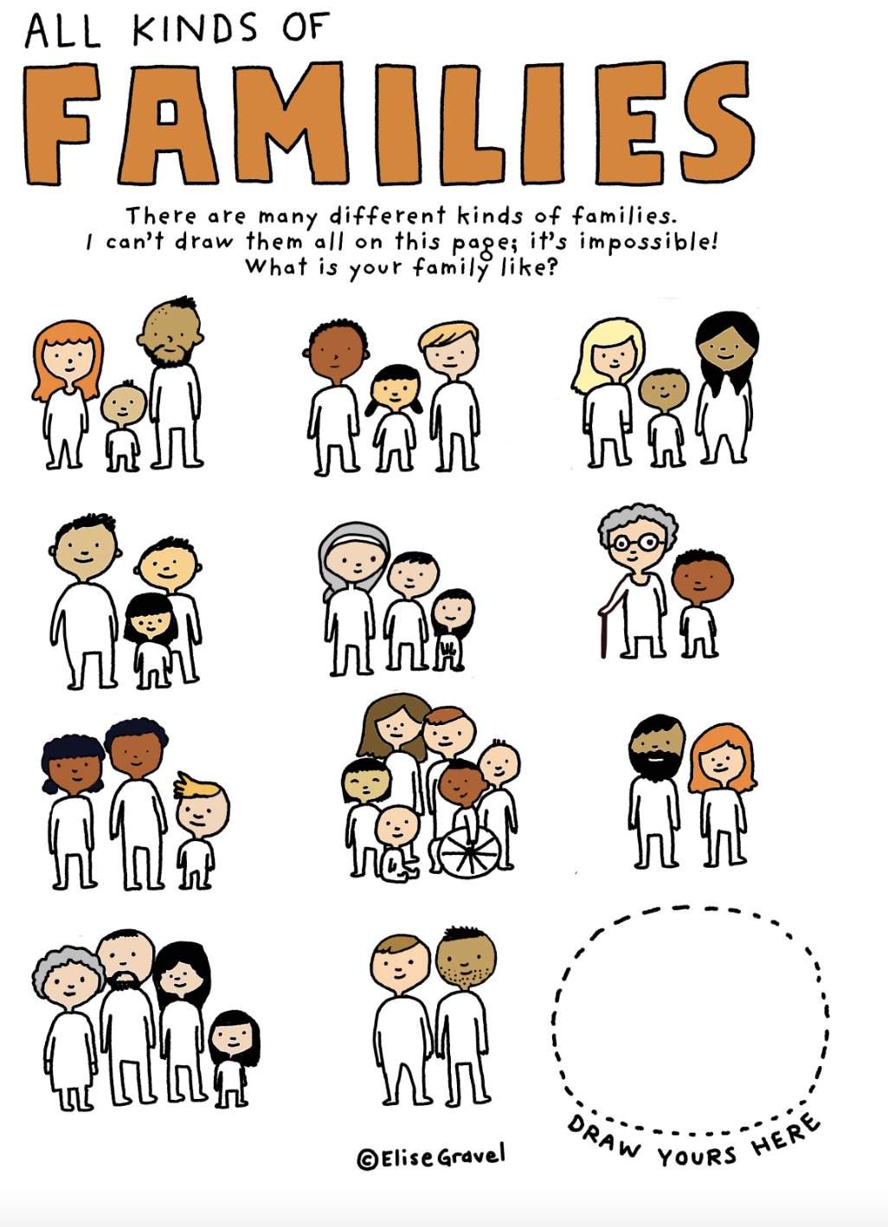

Classroom opportunities to “live your social consciousness” (Switzerland)
I never come from the angle that “I am an activist teacher and I need to teach activist language”, it’s more. Often is really about NOT AVOIDING issues than PROVOKING them. There are occasions for activism everywhere because children are interested in current events and issues and I am not afraid to go with the moment.
http://elisegravel.com/en/livres/free-printable-stuff/
Buechel, forthcoming

Slide 17




"Cultivating habits for a participatory and engaged citizenship" Hytten (2017)
Using multicultural books to:
Raise awareness toward multilingual children
Build empathy
Engage families
Have intentional read alouds
When reading a book in Spanish to an audience of English-only speaking teachers, one teacher said:
"I guess I had never thought about it, but it was very confusing for me. I was totally lost (...) I had no idea what they were saying. It will definitely make me think about what is important for all the children to see in and learn from the book the next time." (Dias et al., 2023)

Slide 18

Activist Curricula
Multicultural Children’s Literature
Texts that foreground the experiences and perspectives of diverse cultural communities
Critical Reader’s Response
Through critical discussion and questioning, learners may become “less likely to exoticize, romanticize or “otherize” members of the marginalized communities”
Smith & Iyengar, forthcoming

Slide 19
Promoting Critical Discussion
What are other possible interpretations of the events in the story?
Who is advantaged/disadvantaged (or silenced/celebrated)?
Could the events be presented in a different way? What would changing this presentation do to the story?

Slide 20

Join networks and build coalitions

Slide 21
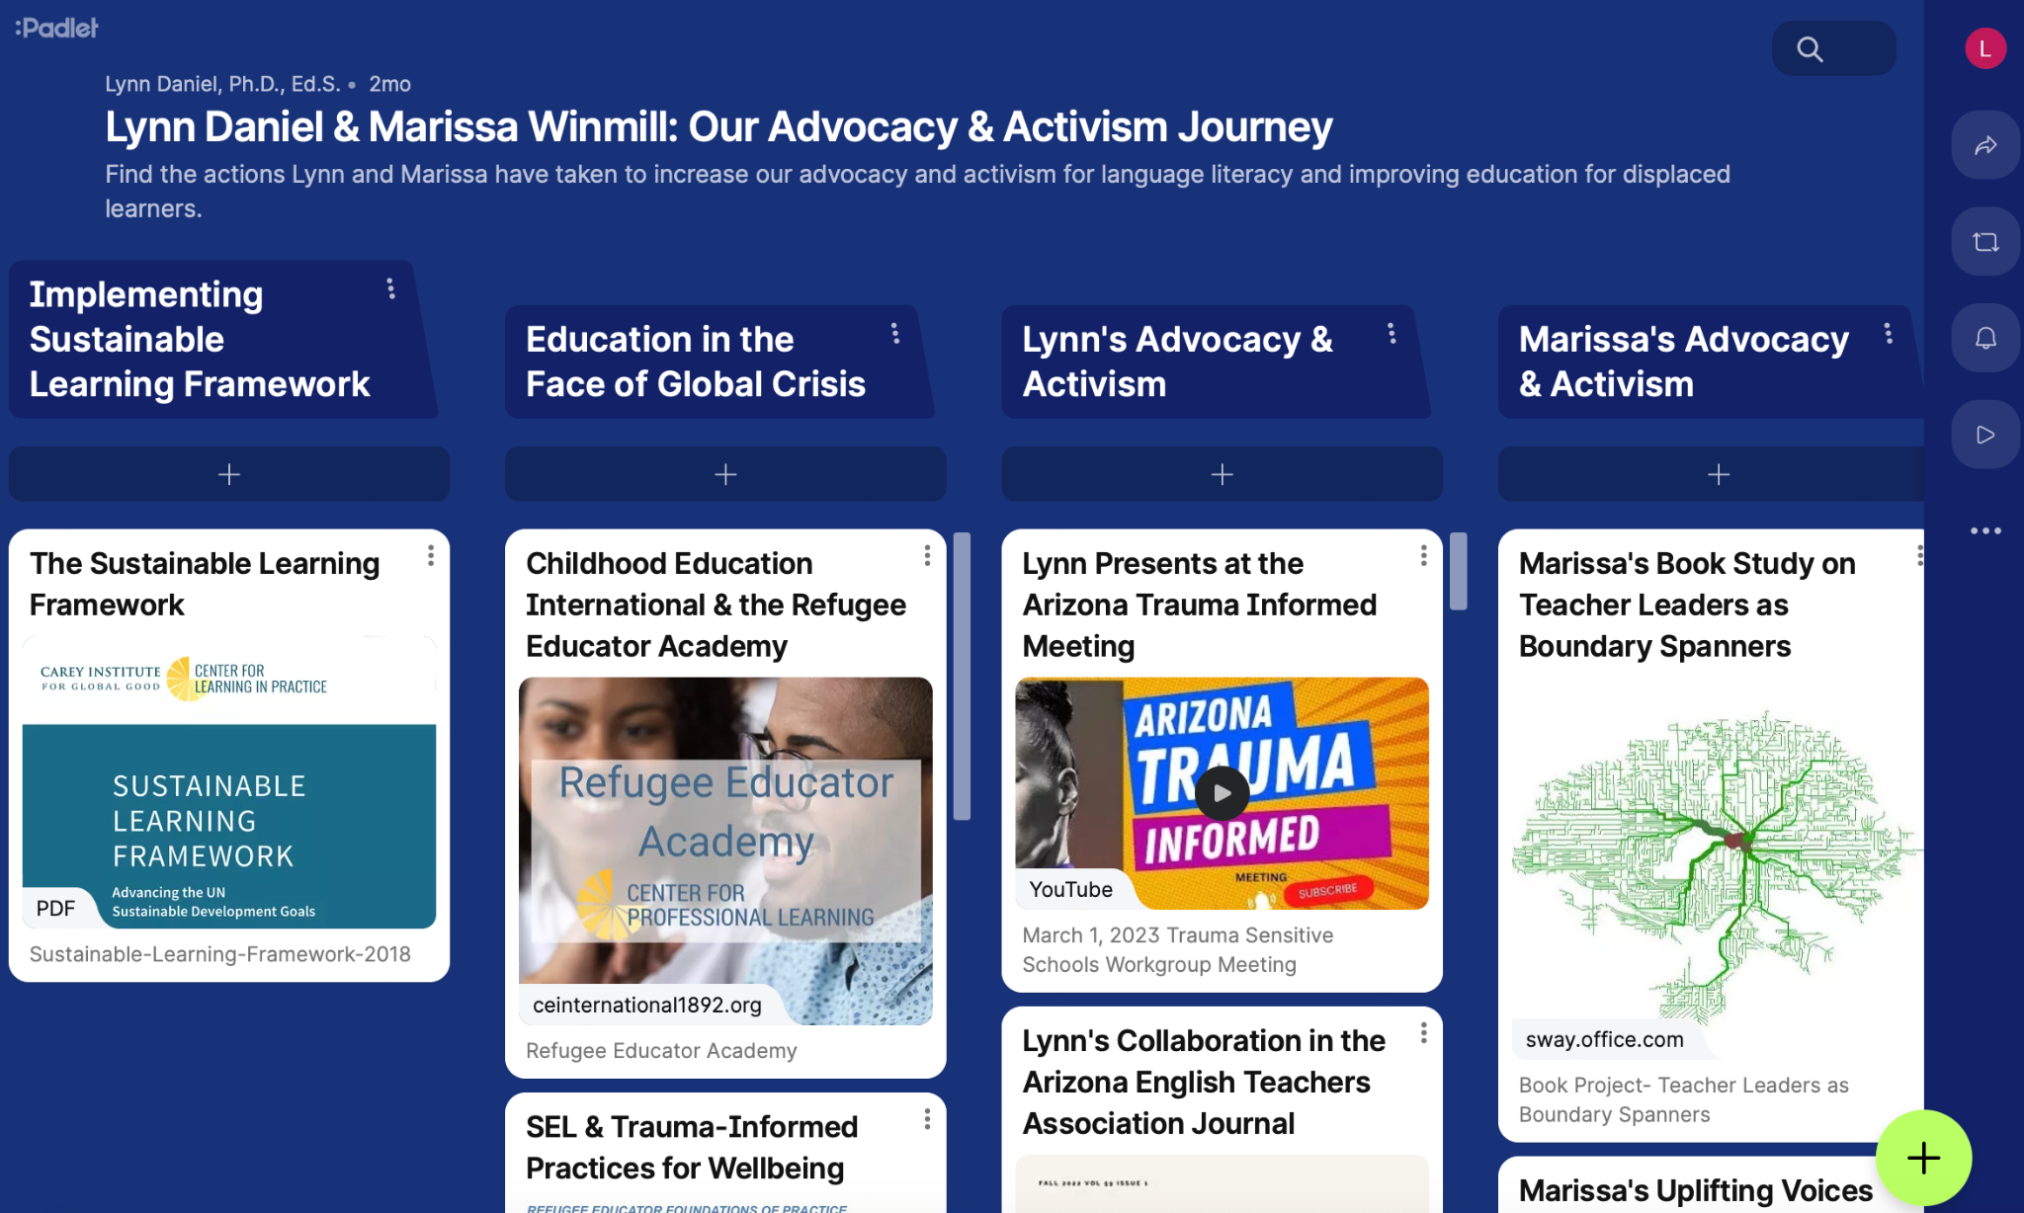

Locating Your Communities of Practice
Daniel & Winmill, 2023; Warren & Ward, 2023

Slide 22

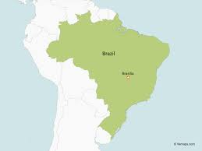
Online Activism Group
Bi-Multilingual Education: Teaching as and for Activism
Online study group with educators, scholars and graduate students in Brazil
2-hour-weekly meetings via Zoom from March to June
Discussion of selected research articles with author participation
Discussion of ongoing research of the group participants

Slide 23
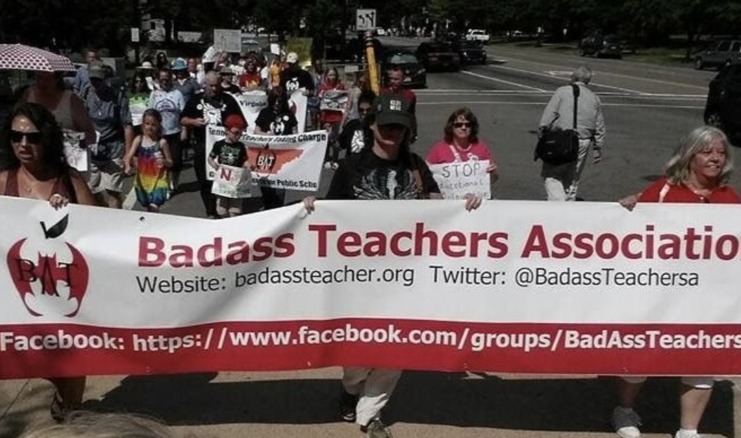
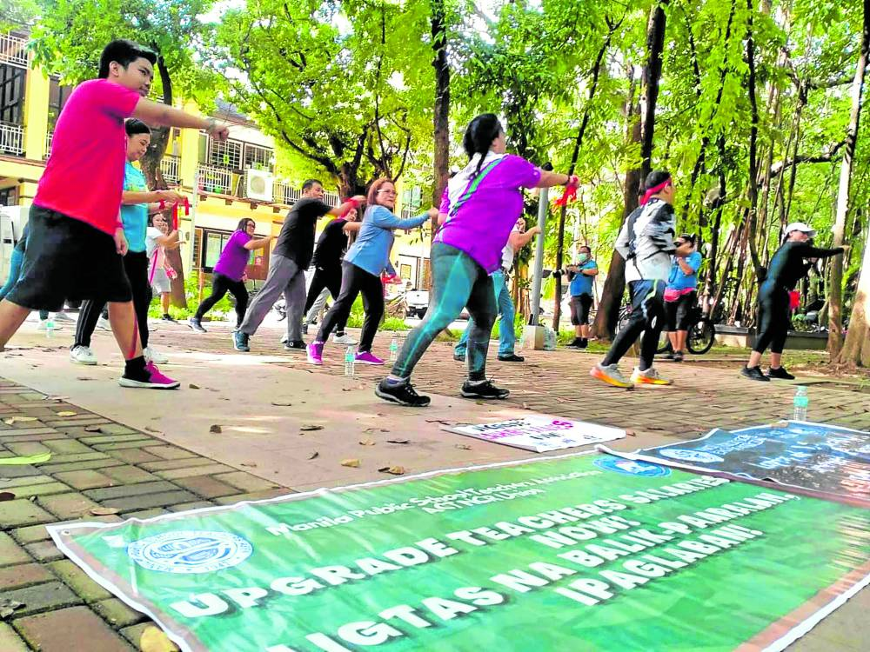
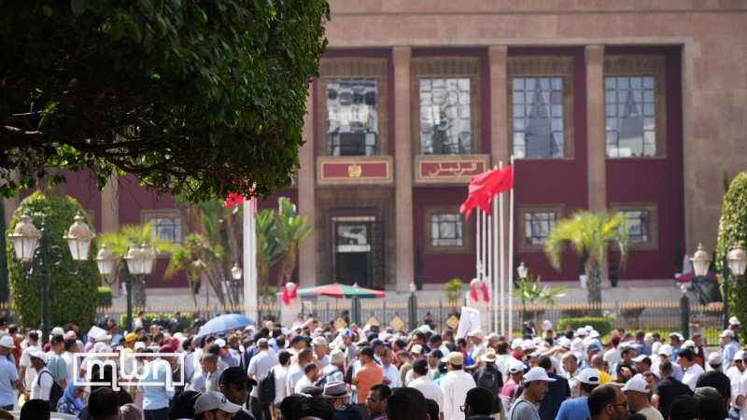
Unions, Strikes, and Community Organizations
Marching to support public schools, USA
Zumba for Better Pay, Philippines, 2022; Source Inquirer.net
Teacher Strike Morocco, 2023; Source: Morocco World News

Slide 24
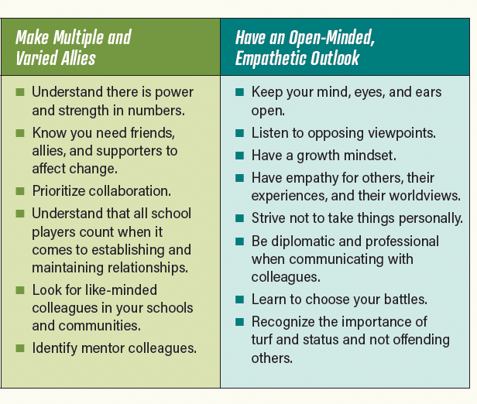
Your Turn!
Linville & Whiting, 2022 Advocating for English Learners

Slide 25
Thank you and keep in touch!
Amber N. Warren
Natalia A. Ward
Maria Dias
Vanderbilt University
amber.warren@
vanderbilt.edu
East Tennessee State University
wardna1@
etsu.edu
East Tennessee State University
diasma@
etsu.edu

